Slide 1
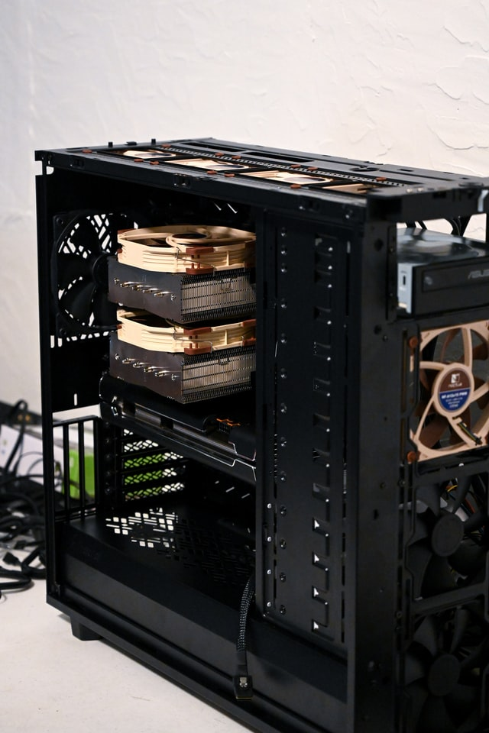
Introduction to Quantum Computing

Slide 2
Quantum Computing 101: How the Quantum Physics
Computer technology has evolved so immensely over the years.
Currently, the trend leans towards quantum computing.
This computing approach can help humans solve various complex problems.
A conceptual understanding about this technology is necessary even at a basic level.

Slide 3
What is quantum computing and how does it work?
It refers to computation that uses the principles of quantum physics. Quantum physics deals with the smallest physical units that exist within the human realm. The common principles applied in the computing system are the superposition, entanglement, and quantum interference.
The computing system is done by quantum computer. A conventional computer works with bits which can be 0 or 1 (a definite number). However, this computing method works with qubits instead. Instead of dealing with one definite problem at a time, it computes numerous probabilities at once.

Slide 4
What would a quantum computer do?
A quantum computer is expected to be able to deal with more problems. Instead of counting the definite problem, it calculates the possible solution for that problem, regardless of the type.
That possibility has a certain amplitude for it to be the right solution. For this to work, the computing system should be in the superposition state.

Slide 5
Three important divisions in the computer system:
Here are the three important divisions in the computer system:
A specific area to house the qubits
The approach to transfer signals to the qubits
A classical computing machine to send instructions towards the system

Slide 6
Is Quantum Computing real?
Many people do not believe that this computing approach is real, or at least they think that the concept is not doable at the moment. Various big companies have worked to develop a computer that operates using quantum principles. However, they still run into some substantial problems.
Although creating a sophisticated quantum computer is not possible at the moment, experts believe that it will be the norm in the future. The system can help human civilization to solve complex modern problems that conventional computers cannot solve right now. Thus, it is understandable that many people are willing to invest in its development.

Slide 7
How will quantum computing change the world?
It might be easier to use illustrations to explain its benefits. Quantum computing is capable of simulating real life situations. Therefore, scientists can create a virtual laboratory that offers a great accuracy to what will happen in the real laboratory. There are so many different implications to the development of human civilization:
People can produce goods at much lower costs because the R&D process occurs in a virtual lab.
The amount of time to create urgent innovations is cut short.
Before manufacturing items, the developers can detect their possible failures and work on solutions.
The manufacturing process becomes more sustainable and environmentally friendly.

Slide 8
Types of quantum computing
There are some types of quantum-based computing system that have been developed in the recent years, such as:
Analog Quantum Analog quantum is the medium tier computing system that applies quantum principles. It can work on several sets of problems at once. The processing time is slightly quicker than conventional computers. It works with 50 to 100 qubits, which means that it is physically doable to build.
Quantum Annealer This computing system is the most restrictive and works comparably to conventional computing machines. Although it uses quantum principles in its application, it can only work on one task at a time. It is an easy build but the advantages over conventional computers are unknown.
Universal Quantum Out of the three quantum computers universal might be the most powerful and versatile. It speeds up the data computing process. However, it takes a lot of resources to build this computer as it is expected to host around 100,000 qubits. That will make the computer unworkable in conventional settings.

Slide 9
What are the applications of quantum computing?
How to apply this computing method in the human realm? Here are some problems that may benefit from quantum solutions:
Simulation The quantum computer is able to crunch enormous data, which includes molecular activity in one being. This ability enables the computer to create very accurate simulations of real life events, such as photosynthesis.
Optimization Instead of calculating a problem at a time, this computing approach solves various probabilities. Through such a system, you can see how each option can provide the most advantages. Thus, you can optimize that option.
Cryptography Cryptography involves difficult mathematical problems such as discrete algorithms and integer factorization. These problems take a long time to solve. However, a computer with quantum principles can do it quickly.
Machine learning This concept is difficult to apply as it takes so much time and financial resources to do it. The computing system can help speed up the process significantly.
Data search Although the conventional computer has evolved so much over the past decades, data search still takes too long sometimes. Quantum principles are capable of speeding up this data search process, especially if the search is unstructured.

Slide 10
What are the advantages of quantum computing?
How will the computing system benefit mankind? Here are some of the advantages of using the system:
It can crunch a large amount of data.
It speeds up data processing time.
It is more money efficient in the long run.

Slide 11
Can physicists take big step in race to quantum computing
Despite the benefits that computing offers, commercial or usable computers still need a long way to go. Here are some common problems in the production process:
The qubits are still difficult to translate into arbitrary values
Readable qubit for public use
Creating a scalable physical system that can support the qubit number
Developing quantum gates that operate faster than the decoherence time
Creating spare parts that can handle the job
These problems are heavily related to physics science. Many companies that aim to produce quantum computers employ physicists to help with computer development. The development of its system relies on various physics concepts. By developing the contemporary quantum physics theories, physicists can make a big leap in the development.

Slide 12
List of quantum computing companies
Some large companies have tried to come up with a quantum computer product that can be used by the larger population, including:
IBM
Microsoft
Google QuAIL
Airbus
Hitachi
Huawei Noah's Ark Lab
The quest for a computer that applies quantum principles but can be utilized by many people is still on-going. We still do not know when the product will be available for many people. However, it is clear that this invention will change human’s lives.

Slide 13
Thank You

